Slide 1
Northwind Company Dashboard
- Priyam Rao and Aditya Dhanekula

Slide 2
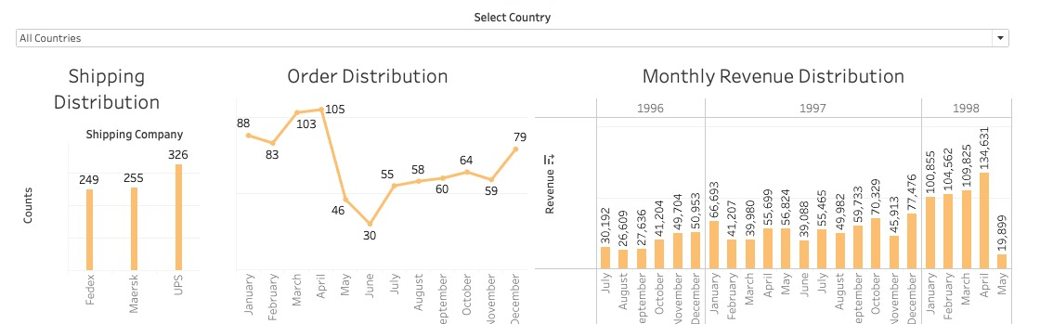
Dashboard: Part 1
The first plot shows the total number of orders delivered by all the shipping companies for each country.
The second plot shows the total number of orders delivered in each month for three years for each country.
The third one shows the monthly revenue distribution for each country.

Slide 3
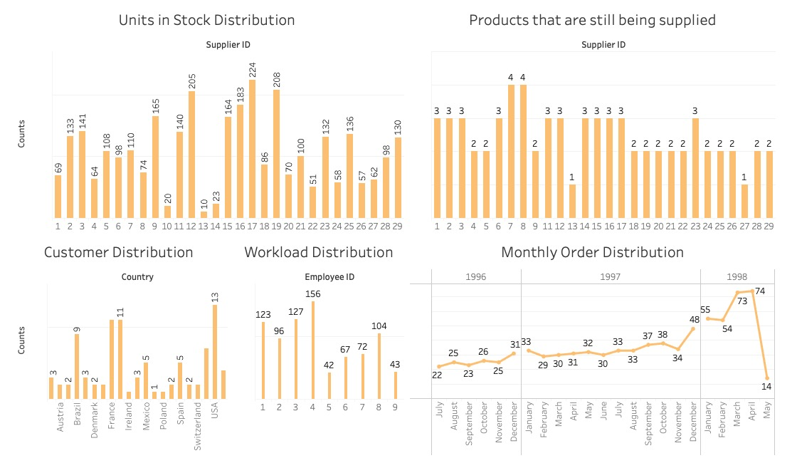
Dashboard: Part 2
The first plot in the figure shows the available number of units in stock supplied by each supplier.
The second plot in the figure describes the number of products supplied by the retained suppliers.
The third one in the figure shows the number of customers in all the countries.
The fourth plot in the figure depicts the workload distribution among employees.
The fifth one in the figure describes the order distribution by month for three years span.

Slide 4
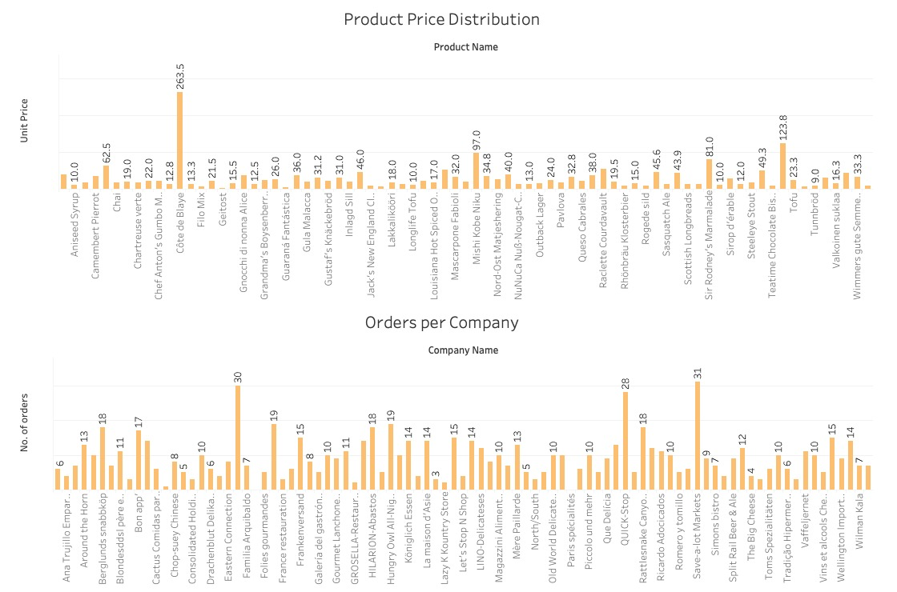
Dashboard: Part 3
The first plot in the figure shows the prices of all the products delivered by the company.
The second plot in the figure describes the total number of orders placed by each company.

Slide 5
Datasets:
ORDER.CSV
OrderID – Ordinal
CustomerID –Categorical
EmployeeID – Categorical
OrderDate – Interval
RequiredDate – Interval
ShippedDate – Interval
ShipVia – Categorical
Freight – Ratio
Shipname – Categorical
ShipAddress – Categorical
ShipCity – Categorical
ShipRegion – Categorical
ShipPostalCode – Categorical
ShipCountry - Categorical

Slide 6
OrderDetails.csv
OrderID – Ordinal
ProductID – Categorical
UnitPrice – Ratio
Quantity – Ratio
Discount - Ratio
Customer.csv
CustomerID – Categorical
CompanyName – Categorical
ContactTitle – Categorical
Address – Categorical
City – Categorical
Region – Categorical
PostalCode – Categorical
Country – Categorical
Phone – Categorical
Fax - Categorical

Slide 7
Products.csv
ProductID – Ordinal
ProductName – Categorical
SupplierID – Ordinal
CategoryID – Ordinal
QuantityPerUnit – Categorical
UnitPrice – Ratio
UnitInStock – Ratio
UnitsInOrder – Ratio
ReorderLevel – Ratio
Discontinued - Ratio

Slide 8
Dashboard Users:
Area Managers:
They are the ones who look over the deliveries.
The dataset shows the number of deliveries made by each employee.
The area manager can evaluate their performance with this information.
Executives and Board Members:
The visualization can help them in determining,
how many orders were placed in a given time period.
They can also see the geographical distribution of the revenue.
We can also determine from where maximum number of orders were placed and from where the least number of orders were placed.

Slide 9
Questions:
What is the workload distribution of the Employees?
How many orders were placed for each company?
How many orders were placed in each month from various countries?
What is the price distribution of the products?
What is the revenue for each month over the entire time period in various countries?
How many orders were placed for specific month for different years?
What is the order distribution among the shipping companies to various countries?
How many customers we have from specific countries?
How many products each supplier provides that are still being supplied?
What is the unitrs in stock distribution based on suppliers?

Slide 10
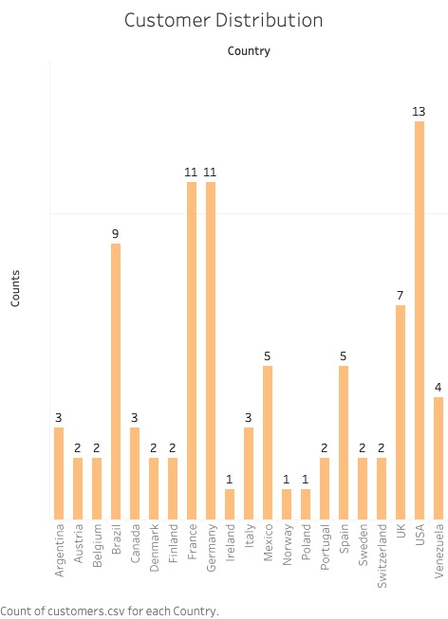
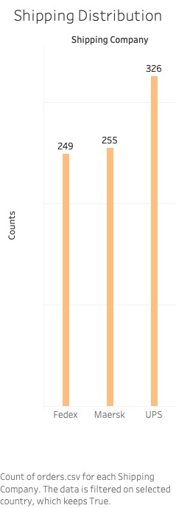
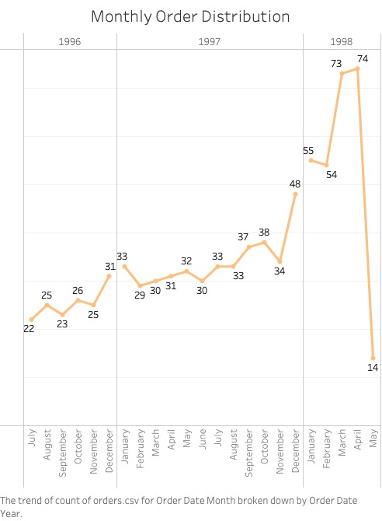
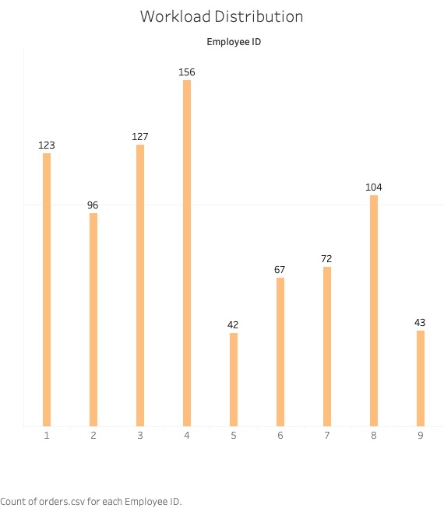
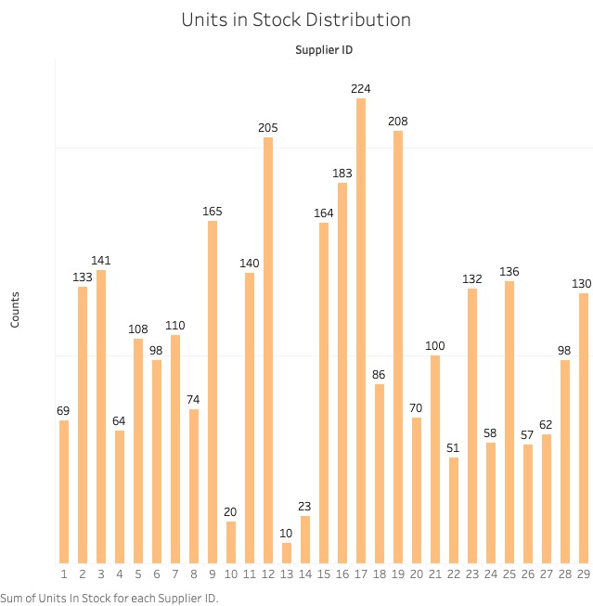
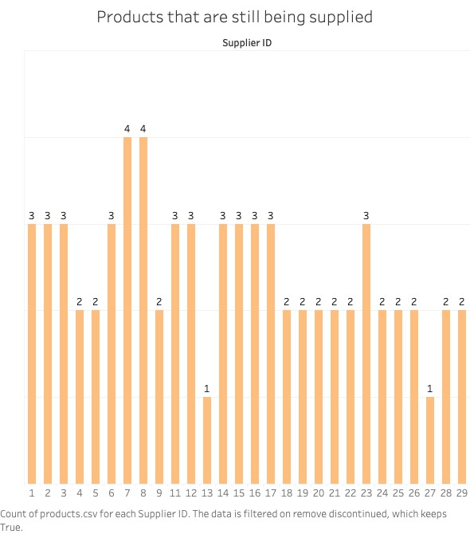
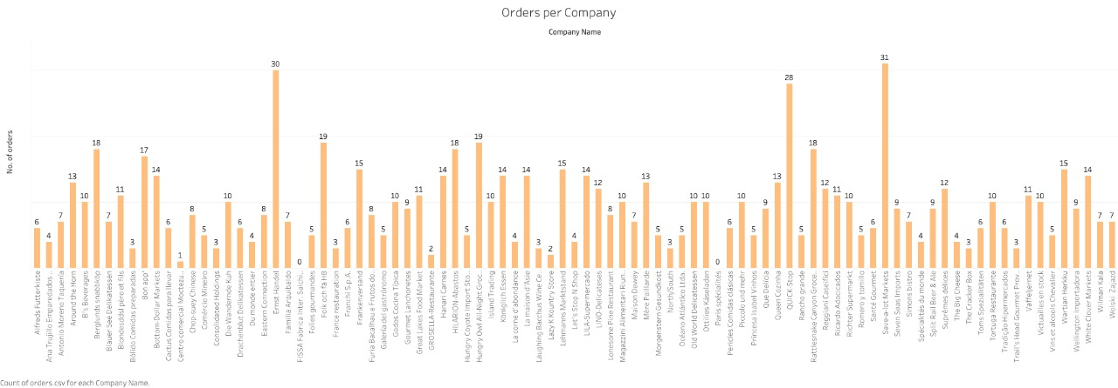
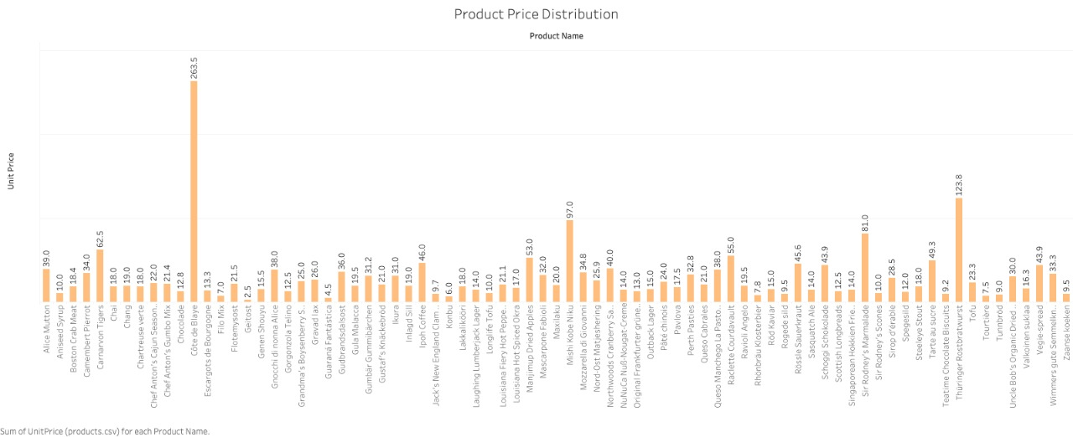
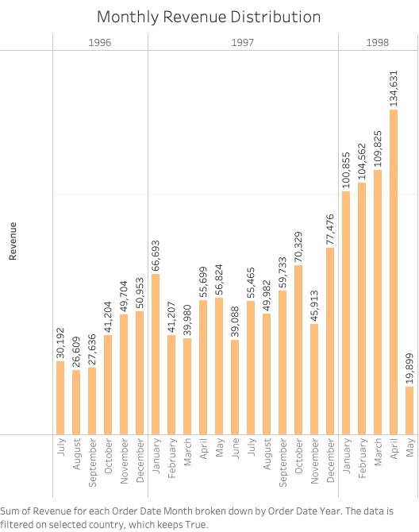
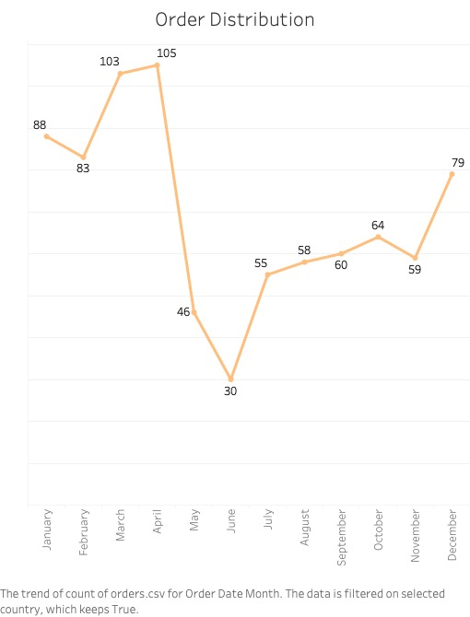
Plots:

Slide 11
The first plot answers the tenth question using bar chart. It shows the number of products that are stock based on the supplier that supplies that product and are not discontinued.
The second plot answers the ninth question using bar chart. It shows the number of products that a supplier is supplying that are not discontinued.
The third plot answers the eighth question using bar chart. It shows the number of customers we have from each country.
The fourth plot answers the seventh question using bar chart. It shows the number of ordered shipped by shipping company.
The fifth plot answers the sixth question using line chart. It shows the orders in each month over the entire time period which is divided based on year.
The sixth plot answers the first question using bar chart. It shows the number of orders that are handled by each employee in our company.
The seventh plot answers the fourth question using bar chart. It shows the price per unit for every product. That our company has shipped.

Slide 12
The eighth plot answers the third question using line chart. It shows the number of orders placed in every month.
The ninth plot answers the second question using bar chart. It shows the number of orders placed by each company which is our customer
The tenth plot answers the fifth question using bar chart. It shows the revenue in each month over the entire time period which is divided based on year.

Slide 13
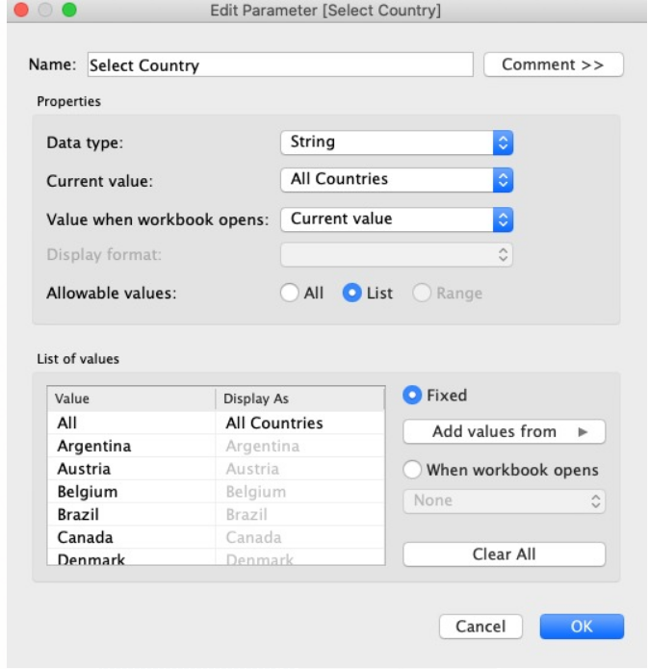
Interactivity
-We implemented one control, which is to select a country. It is a dropdown list created by a parameter.
-The parameter is loaded with ship country column of orders data file. Also, one more value is added to consider all the countries.
-The parameter is applied to plots answering questions 3, 5 and 7. The Parameter structure and details are shown in the picture shown on the side.

